Slide 1
Ethical Issues Related to Economic Justice, Poverty, and Wealth
Name
Institution
Date

Slide 2
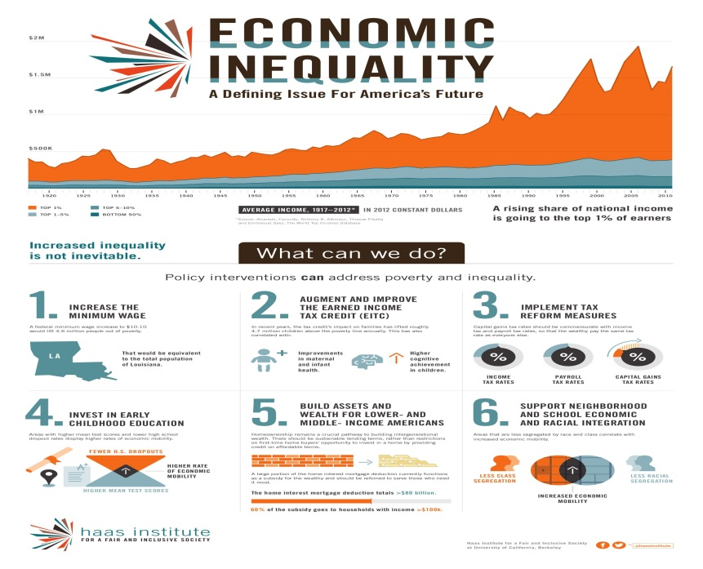
Introduction
Poverty is on the rise in the US
46 million Americans live below the poverty line
Poverty results in inequality
A deep regression and stalled recovery are among the major causes (Semega et al., 2017).
Notes:
It is no doubt that poverty in the United States is on the rise, specifically following an economic crisis caused by the pandemic and stalled recovery. The Census Bureau reports that around 15 percent of the US population, which equates to around 46 million US citizens, lives below the poverty line (Semega et al., 2017). Such a figure is worrying and should trigger the American government and citizens to act swiftly in growing the economy. Poverty results in social inequity and economic injustices.

Slide 3
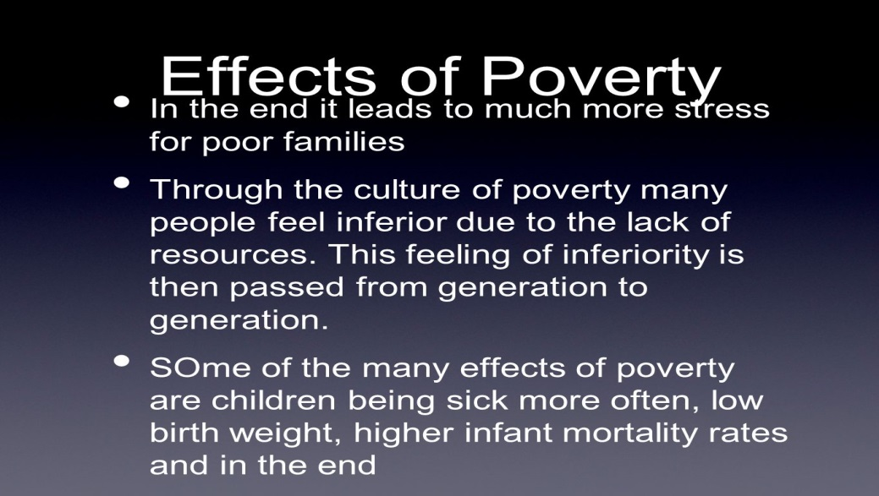
Effects of Poverty and Economic Injustice
Increased criminal activities
Poor public health
Reduced investments
Slow economic growth (Boone et al., 2018)
Notes:
Economic injustice is a sign of poverty. Poverty has the potential to increase criminal activities. Notably, poor people will look for all means they can get themselves food at the table. Some of them may be forced to practice criminal activities like burglary to get money so that they can meet their basic needs. Poverty also results in poor public health. Notably, poor people are not able to access healthy diets, neither are they able to access care services (Boone et al., 2018). As a result, diseases become common among such individuals, thereby posing a public health burden. Poverty also reduced investments since people can only afford money to meet their basic needs. Reduced investments also slow economic growth. Governments may also channel most of their funds to cater to the health of poor people, thereby channeling little or no funds to investment projects.

Slide 4
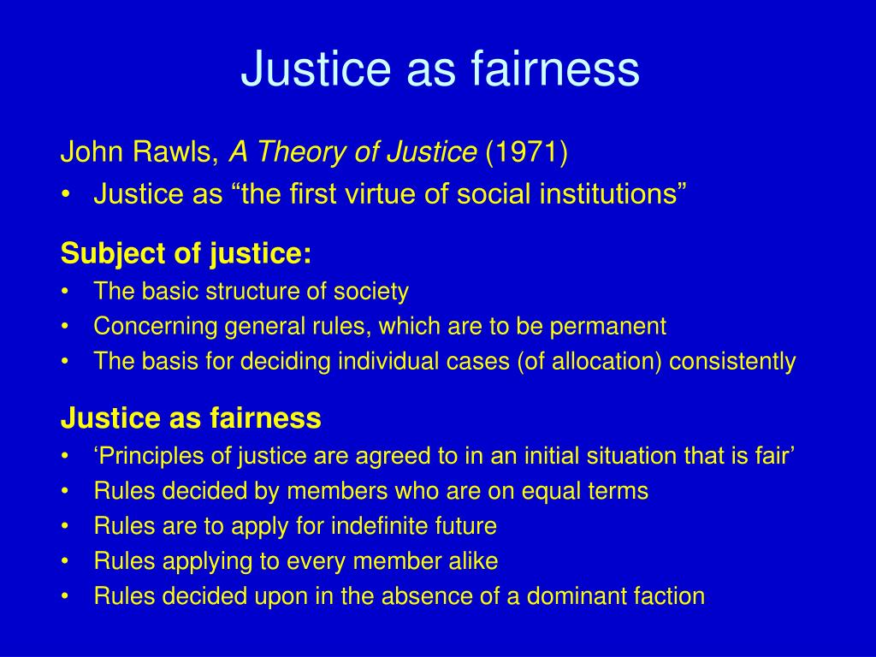
Ethical Theory
The theory of justice as fairness
The theory is developed by John Rawls
Rawls believed in the principle of maxi min
Maximizing opportunities would help in reducing poverty and economic injustices (John, 2017).
Notes:
One of the ethical theories related to economic justice, poverty, and wealth is the theory of Justice and Fairness. Rawls developed this theory to assist societies in ordering their affairs. The theory is based on the principle of maxi min (John, 2017). Notably, societies should maximize opportunities and minimize inequalities. For societies to reduce economic inequality, they should apply the principle of maxi min. This may involve creating more employment opportunities and minimizing barriers to employment opportunities.

Slide 5
References
Boone, K., Roets, G., & Roose, R. (2018). Social work, poverty and anti-poverty strategies: Creating cultural forums. The British Journal of Social Work, 48(8), 2381-2399.
John, R. (2017). Justice as fairness. In Power, Authority, Justice & Rights (pp. 192-218). Routledge.
Semega, J. L., Fontenot, K. R., & Kollar, M. A. (2017). Income and poverty in the United States: 2016. Current Population Reports, (P60-259).

